Slide 1
PROJECT-II (BCSE498J) PANEL REVIEW 1
Impact of El Niño on Groundwater Levels in Chennai: Analysis and Identification of Recharge Potential Areas Using Satellite Imagery and Temporal Data
Shaikh Rumman Fardeen - 21BCE1736
Ojas Aklecha - 21BCE1109
Shashank Kumar - 21BCE1887
Guide : Dr. Sandhya P

Slide 2

AGENDA
Introduction
Literature Review
Problem Statement
Research Challenges
Research Objective
Methodology
Proposed System
What is to be done next
Guide Approval mail snapshot
References

Slide 3
INTRODUCTION
a) Statement of Problem/Challenges
Chennai, a major metropolitan city in India, has been experiencing significant fluctuations in groundwater levels, leading to both water scarcity and flooding issues. These challenges are exacerbated by climatic phenomena such as El Niño, which influences monsoonal patterns and, consequently, groundwater recharge rates. Understanding the specific impacts of El Niño on Chennai's groundwater levels is crucial for developing effective water management and mitigation strategies.
This study aims to address the following research questions:
How does El Niño affect the monsoonal rainfall patterns in Chennai?
What is the correlation between El Niño events and variations in groundwater levels across different wards in Chennai?
Which areas in Chennai exhibit potential for groundwater recharge, and how can these areas be identified using satellite imagery and temporal data?

Slide 4
INTRODUCTION
b) Background, Context, and Significance of Study
El Niño is characterized by the periodic warming of sea surface temperatures in the central and eastern Pacific Ocean, leading to significant alterations in global weather patterns. In the Indian context, El Niño events have been associated with variations in monsoonal rainfall. Specifically, during El Niño years, the southwest monsoon tends to weaken, while the northeast monsoon can become more active, resulting in altered precipitation patterns over South India, including Tamil Nadu.
Chennai relies heavily on monsoonal rainfall for replenishing its groundwater resources. The city receives a substantial portion of its annual rainfall during the northeast monsoon season. However, the influence of El Niño can lead to either excessive rainfall, causing floods, or deficient rainfall, leading to droughts. For instance, the 2015 Chennai floods were partly attributed to an active northeast monsoon season influenced by El Niño, resulting in devastating floods across the city.

Slide 5
INTRODUCTION
Given the critical role of groundwater in Chennai's water supply, understanding the impact of El Niño on groundwater levels is essential. Identifying areas with potential for groundwater recharge can inform the development of targeted interventions, such as the construction of artificial recharge structures and the implementation of rainwater harvesting systems. Utilizing satellite imagery and temporal data allows for a comprehensive analysis of spatial and temporal variations in groundwater levels, facilitating data-driven decision-making for sustainable water resource management.
This study seeks to bridge the knowledge gap by analyzing the correlation between El Niño events and groundwater level fluctuations in Chennai. The findings will contribute to the formulation of effective strategies to mitigate the adverse effects of climate variability on water resources in urban settings.

Slide 6
LITERATURE REVIEW

Slide 7
1. A DEEP LEARNING ALGORITHM FOR GROUNDWATER LEVEL PREDICTION BASED ON SPATIAL-TEMPORAL ATTENTION MECHANISM
Authors: Chong Chen, Xiaoyu Zhu, Xiaobin Kang, Han Zhou
Published in: 2021 IEEE Intl Conf on Dependable, Autonomic and Secure Computing
This study introduces a deep learning-based Spatial-Temporal Attention Long Short-Term Memory (ST-Att-LSTM) model for groundwater level prediction, addressing the computational inefficiencies and limitations of traditional numerical models like MODFLOW and FEFLOW. By integrating spatial and temporal attention mechanisms with a sequence-to-sequence (seq2seq) LSTM structure, the model assigns importance weights to different boreholes (spatial attention) and historical time steps (temporal attention). This approach improves prediction accuracy by capturing spatial and temporal dependencies in groundwater systems.
The study was conducted in the middle reaches of the Heihe River Basin (HRB), a region in northwestern China facing arid conditions and groundwater overexploitation. Groundwater level data (1986–2008) from 42 boreholes were used, focusing on six boreholes for experiments, including one target borehole and five auxiliary boreholes. The ST-Att-LSTM model was evaluated for both short-term (one-month) and long-term (12-month) predictions. After data normalization, the model was trained using 90% of the data, reserving 10% for validation, with hyperparameters optimized for performance.
The ST-Att-LSTM outperformed baseline models, including Support Vector Regression (SVR), Feedforward Neural Networks (FNN), and standard LSTM, achieving superior metrics such as MAE (0.0754) and RMSE (0.0952) in short-term predictions. Spatial attention weights revealed strong hydraulic connections between boreholes, while temporal attention highlighted the significance of recent and seasonal trends.
This study demonstrates the advantages of combining deep learning with spatial-temporal attention mechanisms for accurately predicting groundwater levels. The proposed model offers a computationally efficient and practical tool for groundwater management, particularly in complex hydrological systems. Future research could incorporate additional data, such as meteorological and land use information, and domain knowledge to further enhance the model’s interpretability, reliability, and application scope.

Slide 8
2. FORECASTING UNDERGROUND WATER LEVELS: LSTM-BASED MODEL OUTPERFORMS GRU AND DECISION TREE-BASED MODELS
Authors: Md. Jafril Alam, Sujoy Kar, Sakib Zaman, Shamim Ahamed, Kamrunnesa Samiya
Published in: 2022 IEEE Intl Women in Engineering (WIE) Conference
Groundwater depletion is a global concern, causing water scarcity and challenges in agriculture and industry. Accurate forecasting of groundwater levels is vital for resource management and policy planning. This study evaluates machine learning and deep learning models, including Long Short-Term Memory (LSTM), Gated Recurrent Unit (GRU), Random Forest Regressor, and XGBoost Regressor, for predicting groundwater levels.
The dataset, sourced from the ACEA Group on Kaggle, consists of 49,233 observations with features like rainfall, temperature, river hydrometry, and drainage, targeting groundwater depth. Preprocessing involved handling missing values, feature normalization, and chronological sorting. Models were trained using 80% of the data, with 20% reserved for testing, and evaluated using metrics such as Mean Absolute Error (MAE) and Root Mean Square Error (RMSE).
Deep learning models, particularly LSTM, excelled at capturing temporal dependencies, with the LSTM model achieving the best performance (MAE: 0.144, RMSE: 0.189). GRU followed closely (MAE: 0.168, RMSE: 0.203), while classical models like Random Forest and XGBoost underperformed due to their inability to account for time-series dependencies. LSTM demonstrated better scalability for larger datasets compared to GRU, attributed to its handling of long-term dependencies. Visualization of predicted and actual groundwater levels showed a close match for LSTM and GRU models.
The study underscores the effectiveness of LSTM in groundwater forecasting. Future research could enhance model accuracy by incorporating attention mechanisms and additional features, further strengthening groundwater resource management strategies.

Slide 9
3. GROUNDWATER LEVEL PREDICTION: A NOVEL STUDY ON MACHINE LEARNING-BASED APPROACH WITH REGRESSION MODELS FOR SUSTAINABLE RESOURCE MANAGEMENT
Authors: Md. Jafril Alam, Sujoy Kar, Sakib Zaman, Shamim Ahamed, Kamrunnesa Samiya
Published in: 2022 IEEE Intl Women in Engineering (WIE) Conference
Groundwater is a crucial resource for ecosystems and freshwater needs. Traditional hydrological models often fail to capture the complex interactions of environmental factors affecting groundwater levels. This study proposes a machine learning-based regression approach to address these challenges, emphasizing simplicity, interpretability, and computational efficiency.
The proposed method uses a simple linear regression model to establish linear relationships between groundwater levels and influencing factors. Historical groundwater data, meteorological variables (e.g., rainfall, temperature), and geospatial features were utilized as inputs. Data preprocessing involved normalization and feature selection to reduce dimensionality. Model optimization was conducted using grid search to identify the best hyperparameters. Performance was assessed using Mean Squared Error (MSE) and R-squared metrics.
The linear regression model achieved an MSE of 0.025 and an R-squared value of 0.85, demonstrating high accuracy in capturing groundwater level trends. Compared to complex hydrological models, this approach required minimal computational resources, making it suitable for resource-constrained environments. Additionally, the regression coefficients provided valuable insights into the importance of various environmental factors, helping decision-makers prioritize interventions effectively.
This study highlights the cost-effectiveness and accuracy of using a regression-based approach for groundwater level prediction, especially in regions with limited data availability. By offering interpretable results and requiring fewer resources, this method serves as a practical tool for sustainable water management. Future research could enhance prediction accuracy by incorporating ensemble learning techniques and hybrid models, expanding its applicability to more complex scenarios while maintaining simplicity and efficiency.

Slide 10
4. TIME SERIES-BASED GROUNDWATER LEVEL FORECASTING USING GATED RECURRENT UNIT DEEP NEURAL NETWORKS
Authors: Haiping Lin, et al.
Published in: Engineering Applications of Computational Fluid Mechanics, 2022
Groundwater level forecasting is essential for managing water resources amidst increasing demand and climate variability. Traditional methods often struggle with capturing long-term dependencies in time-series data. This study explores the use of Gated Recurrent Units (GRU) for groundwater level prediction, comparing its performance with Long Short-Term Memory (LSTM) networks.
GRU networks were designed to address the vanishing gradient issue in recurrent neural networks by using reset and update gates to manage memory efficiently. The study utilized historical groundwater data, which was normalized and split into training and validation sets. The GRU model was trained to predict future groundwater levels and compared against LSTM and other models using metrics such as RMSE and MAE.
The GRU model effectively captured temporal dependencies and seasonal patterns in groundwater data, achieving competitive results, though it slightly underperformed compared to LSTM in terms of accuracy. However, GRU required fewer computational resources, making it a more practical choice for scenarios with hardware limitations. The model demonstrated its ability to predict groundwater level trends, providing a valuable tool for water resource management.
In conclusion, GRU offers a computationally efficient alternative to LSTM for groundwater forecasting, with comparable accuracy. Its resource efficiency makes it suitable for regions with limited computational capabilities. Future work could further improve the model by incorporating external factors like rainfall, land use data, and attention mechanisms to enhance prediction accuracy and provide deeper insights for sustainable water management.

Slide 11
5. APPLYING CONVOLUTIONAL LSTM NETWORK TO PREDICT EL NIÑO EVENTS: TRANSFER LEARNING FROM THE DATA OF DYNAMICAL MODEL AND OBSERVATION
Authors: Bin Mu, Shaoyang Ma, Shijin Yuan, Hui Xu
Published in: 2020 IEEE International Conference on Dependable, Autonomic, and Secure Computing
El Niño, the warming phase of the El Niño-Southern Oscillation (ENSO), significantly impacts global weather patterns and socio-economic conditions. Accurate prediction of El Niño events is vital but challenging due to the limited availability of historical observational data. This study proposes a Convolutional Long Short-Term Memory (ConvLSTM) network leveraging transfer learning to predict grid-level sea surface temperature (SST) anomalies and thermocline depth.
The study utilized two datasets: 465 monthly observational samples (1980–2018) and 12,000 months of Zebiak-Cane dynamical model simulations. The ConvLSTM architecture integrates convolutional layers for spatial feature extraction with LSTM layers for temporal modeling, enhanced with seasonal cycle embeddings. Transfer learning was applied by pre-training the ConvLSTM model on Zebiak-Cane data and fine-tuning it using observational data. The model was evaluated through 10-fold cross-validation using RMSE and correlation metrics.
Results showed that transfer learning significantly improved the predictive accuracy of SST anomalies, particularly for strong Eastern-Pacific (EP) El Niño events. The pre-trained ConvLSTM model demonstrated robust generalization, outperforming models trained solely on observational data. However, its performance in predicting Central-Pacific (CP) El Niño events was suboptimal, highlighting a key limitation.
The study demonstrates the potential of combining dynamical simulations and observational data via transfer learning to enhance El Niño prediction. The ConvLSTM model provides a robust framework for addressing data scarcity while improving accuracy. Future research should focus on enhancing CP event predictions and incorporating additional climate variables to further refine model performance and expand its applicability.

Slide 12
6. GSTCN: GRAPH-BASED SPATIAL-TEMPORAL CONVOLUTIONAL NETWORKS FOR ADVANCED ENSO FORECASTING
Authors: Gaojin Shu, Chengyu Liang, Yinbo Yin
Published in: 2023 International Conference on Computer Science and Automation Technology (CSAT)
ENSO (El Niño-Southern Oscillation) is a major driver of global climate variability, and accurate prediction is vital for disaster preparedness and mitigation. Traditional statistical and numerical models often fail to capture the nonlinear dynamics of ENSO. This study presents the Graph-based Spatial-Temporal Convolutional Network (GSTCN), a novel approach integrating graph-based learning and deep learning to enhance ENSO prediction.
The GSTCN model incorporates a Graph Convolution Module to capture spatial relationships between sea surface temperature (SST) and subsurface oceanic variables, and an Informer Module, a Transformer-based mechanism, for modeling long-term temporal dependencies. Historical SST and thermocline depth data were used to train and evaluate the model, targeting the Niño 3.4 index, with a prediction horizon of up to 20 months.
The GSTCN outperformed contemporary deep learning models in predictive accuracy, showcasing its ability to handle large-scale, high-dimensional climate data. The graph convolution module effectively captured evolving spatial patterns, while the Transformer-based Informer module excelled in modeling long-term temporal dependencies. These features made GSTCN both scalable and adaptable for ENSO prediction.
This study highlights the potential of combining graph-based spatial modeling and Transformer-based temporal learning for robust ENSO forecasting. GSTCN offers a powerful framework for understanding and predicting ENSO dynamics. Future research could focus on integrating real-time data streams and hybrid modeling approaches to enhance accuracy further, enabling more reliable predictions for disaster preparedness and climate risk management.

Slide 13
7. TEMPORAL VARIATION OF MODIS NDVI IN THE NORTH COAST JAVA DURING EL NIÑO AND LA NIÑA
Authors: Diego Alejandro Satizábal-Alarcón, Alexandra Suhogusoff, Luiz Carlos Ferrari
Published in: ScienceDirect – Science of the total environment – volume 912, 168958
The Normalized Difference Vegetation Index (NDVI) derived from MODIS data is a key parameter for monitoring vegetation health under varying climate conditions. This study examines the temporal variations in NDVI along the North Coast of Java during El Niño and La Niña events to understand their impacts on vegetation dynamics.
The study utilized MODIS NDVI data for periods corresponding to El Niño and La Niña events. Temporal decomposition was applied to observe NDVI trends during and after these episodes. Statistical correlations between NDVI anomalies and climatic indices, such as the Southern Oscillation Index (SOI) and sea surface temperature (SST), were analyzed. The North Coast of Java, a region highly sensitive to climatic fluctuations, was selected as the study area.
Key findings revealed significant reductions in NDVI during El Niño events, attributed to decreased precipitation and elevated temperatures, which stressed vegetation health. In contrast, vegetation showed rapid recovery post-El Niño. La Niña events resulted in prolonged NDVI increases, reflecting enhanced vegetation growth due to improved rainfall. Spatial analysis indicated disparities in the impact, with agricultural zones being the most affected compared to other land-use types.
The study concludes that MODIS NDVI effectively captures vegetation dynamics influenced by ENSO phenomena. These findings underscore the need for region-specific adaptation strategies to address agricultural and ecological vulnerabilities to ENSO-induced climatic variations. Future research could integrate higher-resolution datasets and explore adaptive management practices to mitigate the impacts of climate variability on vegetation health.

Slide 14
9. LITERATURE REVIEW ON GROUNDWATER STORAGE CHANGES IN THE AMAZON RIVER BASIN
Authors: Diego Alejandro Satizábal-Alarcón, Alexandra Suhogusoff, Luiz Carlos Ferrari
Published in: ScienceDirect – Science of the total environment – volume 912, 168958
Groundwater storage (GWS) is a crucial component of the hydrological cycle, particularly in the Amazon River Basin (ARB), a region of significant global hydrological importance. However, monitoring GWS in the ARB is challenging due to limited ground-based data and complex spatial-temporal variability. While satellite missions like GRACE and GRACE-FO provide large-scale terrestrial water storage (TWS) data, their coarse spatial resolution necessitates downscaling for localized analysis. To address this, machine learning (ML) models, specifically Adaptive Boosting (AB) and Random Forest (RF), were employed to enhance the spatial resolution of GRACE/GRACE-FO data from 1° to 0.25°, using region-specific hydrometeorological and morphological variables. Validation against independent hydrological variables confirmed the reliability of the downscaled data. The models effectively captured GWS variability, with AB slightly outperforming RF in terms of accuracy, and highlighted significant GWS changes in the ARB between 2002 and 2021, driven by climatic and anthropogenic factors. This study demonstrates the potential of ML techniques to address the limitations of coarse-resolution satellite data, offering high-resolution insights into GWS dynamics. Future research should explore advanced ML methods, such as deep learning, and integrate additional remote sensing datasets to further enhance predictive capabilities and assess the implications of GWS variability on regional water resources and ecosystems under changing climatic conditions.

Slide 15
10. LITERATURE REVIEW ON DROUGHT MODELING USING MACHINE LEARNING APPROACHES
Authors: Karpagam Sundararajan, Lalit Garg Kathiravan Srinivasan, Ali Kashif Bashir, Jayakumar Kaliappan, Ganapathy Pattukandan Ganapathy, Senthil Kumaran Selvaraj and T. Meena
Published in: Tech Science Press – Computer Modelling in Engineering & Sciences
Drought is a slow-developing natural disaster marked by prolonged precipitation deficits, severely affecting ecosystems, agriculture, water resources, and socio-economic systems. Its complexity and propagation through the hydrological cycle make prediction challenging. With advancements in computational intelligence, machine learning (ML) has emerged as a robust tool for drought prediction, offering data-driven solutions to improve accuracy and efficiency.
Drought indices are essential for quantifying and forecasting drought conditions. Common indices include the Standardized Precipitation Index (SPI), Palmer Drought Severity Index (PDSI), and Normalized Difference Vegetation Index (NDVI), which monitor precipitation deficits, soil moisture, and vegetation health. ML models leverage these indices to enhance drought prediction accuracy, measured through metrics like Root Mean Square Error (RMSE) and Nash-Sutcliffe Efficiency (NSE).
Key ML methodologies for drought prediction include Artificial Neural Networks (ANNs), which excel in capturing complex relationships; Support Vector Machines (SVMs) for handling non-linear data; Random Forests (RFs) for feature selection and ensemble learning; and Long Short-Term Memory (LSTM) networks, which model temporal dependencies effectively. Hybrid approaches, such as wavelet-ANNs or LSTM-Gaussian Process Regression (GPR), further enhance performance by combining complementary techniques.
Findings highlight the superiority of hybrid models, the integration of climatic indicators like ENSO, and the effectiveness of ML for short-term predictions. However, challenges persist, including limited availability and quality of historical climate data, high computational costs, and the interpretability of complex ML models.
Future directions emphasize integrating multi-source datasets, exploring advanced ML techniques like reinforcement learning, and focusing on explainable AI to improve stakeholder trust. ML-based drought models show significant promise in addressing the limitations of traditional methods and can play a vital role in managing drought impacts, provided ongoing innovations continue to improve their reliability and applicability globally.

Slide 16
11. LITERATURE REVIEW ON URBAN GROUNDWATER VULNERABILITY UNDER CLIMATE CHANGE AND MANAGEMENT SCENARIOS
Authors: M Shekhar, M Shindekar, Sat K Tomer, P Goswami
Published in: Earth Interactions – Volume 17
Groundwater is vital for urban and rural areas, especially in regions like southern India, where it supports 85% of rural domestic and 50% of urban water demands. However, rapid urbanization and climate variability have increased groundwater vulnerability, resulting in reduced recharge, declining water levels, and deteriorating water quality. Despite progress in understanding groundwater dynamics, the combined impacts of urbanization and climate change remain underexplored.
Urbanization significantly alters groundwater cycles through increased pumping, reduced recharge, and wastewater leakage, affecting both water quantity and quality. Climate change further exacerbates groundwater stress, with rising temperatures and erratic rainfall patterns reducing recharge rates. Groundwater modeling approaches, such as lumped and distributed models, along with advanced tools like PORFLOW, enable high-resolution scenario analysis for groundwater management. Effective strategies, such as induced recharge through lakes and controlled pumping, combined with policy measures, are essential for addressing groundwater stress in urban areas.
A study in Mulbagal, Karnataka, analyzed groundwater vulnerability using data from 272 monitoring wells collected between 2008 and 2011. Simulations revealed that annual recharge from rainfall averaged 68mm, while reductions in lake recharge and increased pumping led to significant groundwater declines. Climate projections from six GCMs showed that combined scenarios, including reduced recharge and enhanced pumping, could result in groundwater levels dropping by 20 meters near pumping stations over 20 years.
Key findings emphasize the critical role of lake recharge in mitigating groundwater depletion and the risks posed by wastewater leakage. Policy recommendations include developing managed aquifer recharge projects, conducting detailed groundwater mapping, and integrating findings into urban planning. The study highlights the importance of integrating climate projections and urban management practices into groundwater sustainability strategies, offering a replicable framework for addressing urban groundwater challenges globally.

Slide 17
12. MAPPING AND ASSESSING SPATIAL EXTENT OF FLOODS FROM MULTITEMPORAL SYNTHETIC APERTURE RADAR IMAGES: A CASE STUDY OVER CHENNAI CITY, INDIA
Authors: Sreechanth Sundaram, Suresh Devaraj, Kiran Yarrakula
Published in: Research Square
Urban flooding is a significant global concern, particularly in densely populated areas, as it causes severe economic losses and risks to human life. Studies highlight the rising frequency of urban floods in Indian cities like Chennai, attributed to rapid urbanization, inadequate infrastructure, and climate change (Chaudhary & Piracha, 2021; Sundaram et al., 2021). Chennai’s catastrophic 2015 floods, linked to extreme rainfall during El Niño, underscore the city’s vulnerability, exacerbated by unplanned urban development and poor resource management (Rasti et al., 2018; Ehrlich et al., 2021).
Remote sensing technologies, especially Synthetic Aperture Radar (SAR), have proven effective in flood mapping and disaster management due to their ability to operate under all weather conditions, unlike optical sensors hindered by cloud cover (Huang et al., 2015; Vickers et al., 2019). Advanced SAR methodologies, such as ISODATA techniques, thresholding, and multi-temporal analysis, enhance flood delineation. Techniques like the Grey Level Co-Occurrence Matrix further improve accuracy in detecting flooded regions (Zhang et al., 2020).
The advent of satellite missions, including ESA’s Sentinel, has revolutionized earth observation by providing high-resolution SAR data for flood risk assessments (Nagler et al., 2015). Historical data from Chennai show a correlation between urban development and increased flood risks, necessitating improved urban planning strategies (Kookana et al., 2020).
The literature emphasizes the integration of remote sensing technologies and urban planning to mitigate flood impacts. The case study on Chennai demonstrates SAR’s potential in advancing flood monitoring and risk management, underscoring the need for continued research to refine methodologies and predictive capabilities.

Slide 18
13. FLOOD SUSCEPTIBILITY MAPPING OF NORTHEAST COASTAL DISTRICTS OF TAMIL NADU INDIA USING MULTI-SOURCE GEOSPATIAL DATA AND MACHINE LEARNING TECHNIQUES
Authors: Saravanan Subbarayan, Abhijith Devanatham
Published in: Research Gate
Flooding is among the most devastating natural disasters, intensified by climate change, which has increased the frequency and severity of extreme precipitation events. Globally, water-related disasters account for 74% of all natural disasters, causing significant socioeconomic losses and property damage [1]. In India, regions like Tamil Nadu are particularly vulnerable, exemplified by the catastrophic 2015 floods driven by cyclonic activity and poor urban planning. These events underscore the need for robust flood susceptibility mapping to mitigate future risks [1].
Flood susceptibility mapping employs methodologies ranging from multi-criteria decision analysis (MCDA) and statistical methods to advanced machine learning (ML) and deep learning techniques. Traditional methods, often constrained by linear assumptions, fall short in capturing the complex nature of flooding. In contrast, ML approaches like Gradient Boosting Machine (GBM), XGBoost, Support Vector Machine (SVM), and Naive Bayes (NB) excel in modeling non-linear relationships and extracting patterns from historical data, making them highly effective for flood risk assessment [1].
The role of remote sensing and geospatial data has been transformative in flood mapping. Platforms like Google Earth Engine (GEE) enable efficient processing of satellite imagery, while SAR data from missions like Sentinel-1 facilitate precise monitoring of flood extents under diverse weather conditions. Integrating remote sensing with ML significantly enhances the accuracy and reliability of flood susceptibility maps [1].
Feature selection is pivotal in optimizing ML models for flood mapping. Techniques like Recursive Feature Elimination (RFE) refine input variables, eliminating weak predictors and boosting model performance [1]. Ensemble approaches further enhance predictions while balancing computational efficiency.
Studies affirm that ML models outperform traditional methods, effectively identifying flood-prone areas based on historical data without requiring deep physical process understanding. Integrating ML and remote sensing offers a promising path for improving flood risk management in vulnerable regions like Tamil Nadu. Future research should focus on refining algorithms and expanding their applicability across diverse geographic contexts.

Slide 19
14. THE IMPACT OF CLIMATE CHANGE ON GROUNDWATER AND CROP YIELD IN ASIA: A COMPREHENSIVE LITERATURE REVIEW
Authors: Anandhi Santhosh, Sujatha Prabhakaran, Davamani Veeraswamy, Asadi Srinivasulu, Alvin Lal, Ravi Naidu
Published in: Pre-Prints
Asia, the world’s largest and most populous continent, faces significant environmental challenges due to climate change. The region is warming faster than the global average, with mean temperatures in 2022 showing notable increases compared to historical baselines. This accelerated warming threatens water resources, agriculture, and human settlements, particularly in low-lying coastal areas of countries like Bangladesh and Indonesia, where sea-level rise could displace over 180 million people.
Climate change is severely impacting groundwater recharge, availability, and quality across Asia. South Asia, in particular, faces critical groundwater depletion, losing approximately 60 billion cubic meters annually. Rising air temperatures exacerbate evapotranspiration rates, intensifying the strain on water resources. This depletion is most acute in agricultural regions, where expanding irrigation demands are unsustainable.
Agriculture in Asia is highly vulnerable to climate change. Temperature increases, altered precipitation patterns, and frequent extreme weather events are projected to reduce crop yields. For example, while wheat yields in some areas may slightly increase, maize yields could decline by up to 16.3%. Shifts in temperate zones are altering the geographical suitability for crops such as rice, cotton, wheat, and maize, disrupting agricultural productivity.
Machine learning techniques are emerging as powerful tools for analyzing and predicting climate change impacts. Models like Random Forest, Support Vector Regression, and Extreme Gradient Boosting outperform traditional statistical methods by capturing non-linear relationships between climate variables and outcomes like groundwater levels and crop yields.
The review emphasizes the importance of sustainable water management and climate-resilient agricultural practices, such as groundwater recharge technologies, need-based irrigation, and strategic crop selection. Integrating these practices with soil properties and emerging technologies can enhance system resilience.

Slide 20
15. COMPARATIVE ANALYSIS OF DEEP LEARNING AND SWARM-OPTIMIZED RANDOMFOREST FOR GROUNDWATER SPRING POTENTIAL IDENTIFICATION IN TROPICAL REGIONS
Authors: Viet-Ha Nhu, Pham Viet Hoa, Laura Melgar-García and Dieu Tien Bui
Published in: Remote Sensing MDPI
The study evaluates the effectiveness of deep neural networks (DeepNNs) and swarm-optimized random forests (SwarmRFs) in predicting groundwater spring potential in Gia Lai province, Vietnam, a region characterized by its tropical monsoon climate, varied topography, and agricultural-driven groundwater exploitation. A comprehensive database of 938 groundwater spring locations, encompassing water flow (0.01–118.35 L/s) and mineralization (0.01–0.980 g/L), was analyzed alongside 12 influencing factors such as geology, land use, rainfall, remote sensing indices (NDVI, NDMI, NDWI), and topographic variables derived from advanced datasets like Landsat 8 imagery and ALOS DEM. Feature selection using a wrapper method identified geology as the most critical factor, with elevation, NDVI, and NDMI also being significant contributors. The DeepNN model utilized a three-layer architecture optimized with the ADAM algorithm, while the SwarmRF model incorporated hyperparameter optimization using the Harris Hawks Optimizer (HHO). Both models demonstrated robust predictive capabilities, with SwarmRF outperforming DeepNN in validation accuracy (80.2% vs. 77.9%), a difference confirmed as statistically significant by the Wilcoxon signed-rank test (p-value = 0.011). Groundwater spring potential maps generated from both models provide valuable insights into the spatial distribution of groundwater resources, with geology emerging as the primary determinant of spring potential. While both models are effective, SwarmRF offers an edge due to its slightly higher accuracy and the interpretability inherent to the random forest approach. The findings underscore the importance of geology and other environmental factors in groundwater modeling, providing essential guidance for sustainable water resource management in Gia Lai province. The integration of advanced algorithms like SwarmRF with geospatial data enhances the reliability of predictions and supports informed decision-making for sustainable development in regions facing growing water demands.

Slide 21
PROBLEM STATEMENT
The project addresses the challenges posed by fluctuating groundwater levels in Chennai, driven by the irregular impacts of El Niño on monsoonal rainfall. These climatic variations result in water scarcity, flooding, and inadequate recharge. By analyzing groundwater trends and identifying recharge potential areas, the study aims to promote sustainable water resource management and climate resilience.

Slide 22
RESEARCH CHALLENGES
1. Data Collection and Availability:
Climate Data:
Gaps in historical data for rainfall, temperature, and El Niño-related precipitation data for Chennai.
Difficulty in obtaining complete and consistent records due to varying meteorological reporting standards.
Groundwater Data:
Lack of granular datasets for specific regions and timeframes (e.g., limited data for small localities).
Insufficient monitoring infrastructure in certain areas.
Satellite Imagery:
Limited access to high-resolution satellite images.
High costs associated with procuring satellite imagery for detailed analysis.

Slide 23
RESEARCH CHALLENGES
2. Data Quality and Standardization:
Variability Across Sources:
Different data sources (e.g., meteorological data, groundwater datasets) have varying formats, resolutions, and accuracy levels.
Inconsistent data structures and units pose challenges for integration.
Standardization Challenges:
Difficulties in harmonizing datasets to create a unified dataset for modeling.
Ensuring the reliability of different datasets for accurate analysis.
3. Modeling Challenges:
Predictive Model Development:
Groundwater level modeling must account for complex interactions between climate variables, geology, and urban infrastructure.
Predictive accuracy can be compromised when models are trained on limited or incomplete datasets.
Model Training Limitations:
Limited availability of ground truth data for model validation leads to potential inaccuracies in predictions.

Slide 24
RESEARCH CHALLENGES
4. Identifying Suitable Locations:
Infiltration Capacity Detection:
Identifying optimal locations for groundwater recharge requires advanced image processing and classification techniques using satellite imagery.
Complex urban constraints must be factored in, balancing available space with hydrological feasibility.
5. Field Validation:
On-ground Verification:
Validation of model predictions with real-world conditions (e.g., confirming the suitability of proposed rainwater harvesting and storage systems) is challenging but essential.
Requires extensive field studies and ground-truthing in targeted areas.

Slide 25
RESEARCH CHALLENGES
6. Integration of Multidisciplinary Approaches:
Data Integration Challenges:
Combining hydrological, climatological, remote sensing, and urban planning data into a cohesive analytical framework is complex.
Potential conflicts between urban development plans and proposed water storage solutions need to be resolved.

Slide 26
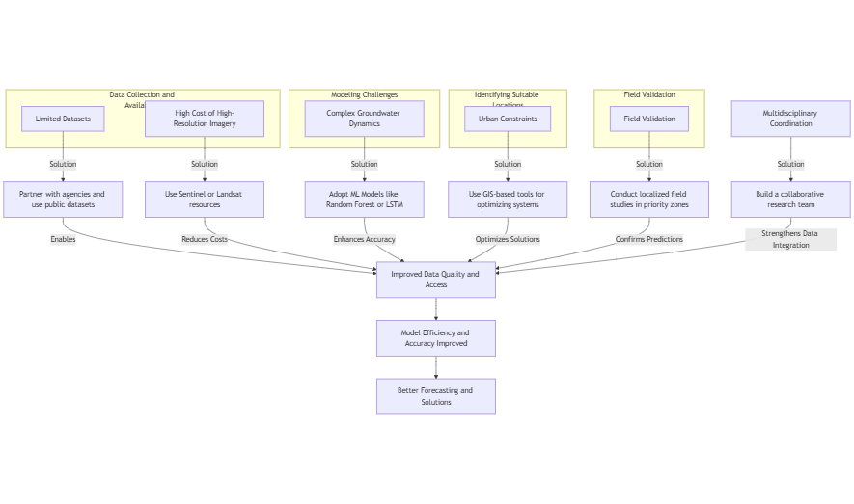
RESEARCH CHALLENGES

Slide 27
RESEARCH OBJECTIVES
Objective 1: Predict Groundwater Levels
Actions:
Leverage historical climate and groundwater data.
Develop models that can predict fluctuations in groundwater during the El Niño season.
Outcome: Better predictions for El Niño season groundwater variations.
Objective 2: Identify Suitable Locations for Rainwater Harvesting
Actions:
Analyze satellite imagery.
Use groundwater models to identify areas for constructing rainwater storage facilities.
Consider topographic and soil characteristics to ensure efficient rainwater infiltration.
Outcome: Identify optimal locations for constructing artificial water storage.
Objective 3: Enhance Groundwater Recharge
Actions:
Utilize identified rainwater harvesting sites for groundwater recharge.
Target areas experiencing groundwater depletion (urban and peri-urban regions).
Outcome: Recharge and improve groundwater sustainability in critical areas.

Slide 28
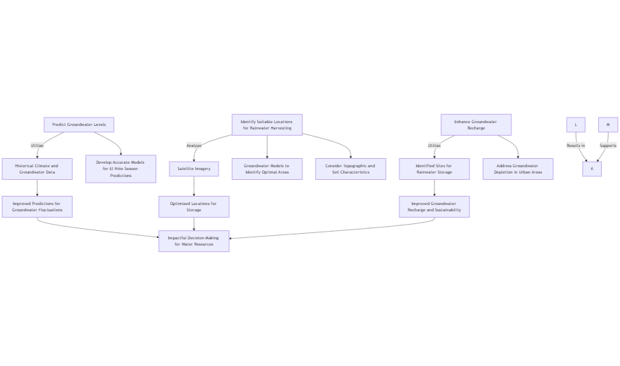
RESEARCH OBJECTIVES

Slide 29
METHADOLOGY
The aim of this project is to analyze El Niño's impact on Chennai's groundwater and recharge potential.
I. MODULES/ALGORITHMS/FUNCTIONALITIES/PROTOCOLS
Data Collection
Data Preprocessing
Analysis Modules
Recharge Potential Identification
Datasets:
Historical groundwater level data (2021–2024) for Chennai, ward-wise.
Satellite imagery from sources like USGS Earth Explorer or ISRO's Bhuvan portal.
Rainfall Data: Monthly rainfall data corresponding to El Niño years.
Data Cleaning: Handle missing, inconsistent, or erroneous data in groundwater and rainfall datasets.
Normalization: Standardize groundwater levels and rainfall data for consistent analysis.
GIS Integration: Georeference satellite images to align with Chennai's ward boundaries.
Temporal Trend Analysis:
Use Python libraries (e.g., Pandas, Matplotlib) to compute annual and monthly groundwater trends across wards.
Identify wards with declining, stable, or increasing trends.
Statistical Correlation:
Correlate El Niño events with variations in rainfall and groundwater levels using Pearson or Spearman correlation coefficients.
Image Classification:
Use remote sensing techniques (e.g., NDVI or NDWI indices) to identify low-lying areas and water bodies.
Implement Python libraries like Rasterio, GDAL, and OpenCV for analysis.
Soil and Slope Analysis:
Extract slope data from Digital Elevation Models (DEMs) to locate areas conducive to groundwater recharge.

Slide 30
METHADOLOGY
I. MODULES/ALGORITHMS/FUNCTIONALITIES/PROTOCOLS
Prediction and Modeling
Proposed Functionalities
Protocols Followed
Remote Sensing Standards: Use open-source GIS platforms adhering to standard geospatial protocols.
Groundwater Data Standards: Align with guidelines provided by the Central Ground Water Board (CGWB), India.
Machine Learning:
Train regression models (e.g., Linear Regression or Random Forest) to predict groundwater fluctuations based on rainfall and El Niño data.
GIS-Based Decision Support:
Overlay identified recharge zones with ward boundaries to prioritize intervention areas.
Visualizations:
Create heatmaps, time-series graphs, and GIS-based maps to visualize trends and recharge areas.
Actionable Recommendations:
Suggest specific wards for implementing recharge structures and rainwater harvesting systems.

Slide 31
METHADOLOGY
II. DATA COLLECTION APPROACHES/STRATEGIES
Approach 1: Historical Data Collection
Description: Groundwater level and rainfall data collected from government databases, research reports, and open datasets (e.g., CGWB, IMD, or local Chennai authorities).
Advantage of Strategy
Limitation of Strategy
Potential Risk
Ethical Issues
Reliable and structured data from official sources.
Historical trends provide insights into long-term variations.
Limited granularity; some ward-level data may be missing or aggregated.
Dependence on the availability and consistency of records.
Data gaps or outdated records may skew analysis.
Errors in transcription or digitization from physical records.
None directly, as this data is public and anonymized.
Transparency in citing data sources is essential to maintain credibility.

Slide 32
METHADOLOGY
II. DATA COLLECTION APPROACHES/STRATEGIES
Approach 2: Remote Sensing and Satellite Imagery
Description: Acquisition of satellite images (e.g., Landsat, Sentinel-2) for Chennai to analyze recharge potential areas using GIS techniques.
Advantage of Strategy
Limitation of Strategy
Potential Risk
Ethical Issues
High spatial resolution allows precise identification of land features.
Accessible through open platforms like USGS Earth Explorer.
Requires technical expertise in image processing and GIS tools.
Limited temporal resolution may miss real-time changes.
Cloud cover or low-quality images can impact analysis accuracy.
High computational resources required for image processing.
Ethical handling of satellite imagery is crucial to avoid misuse.
Consideration of public privacy when integrating satellite and ground-level data.

Slide 33
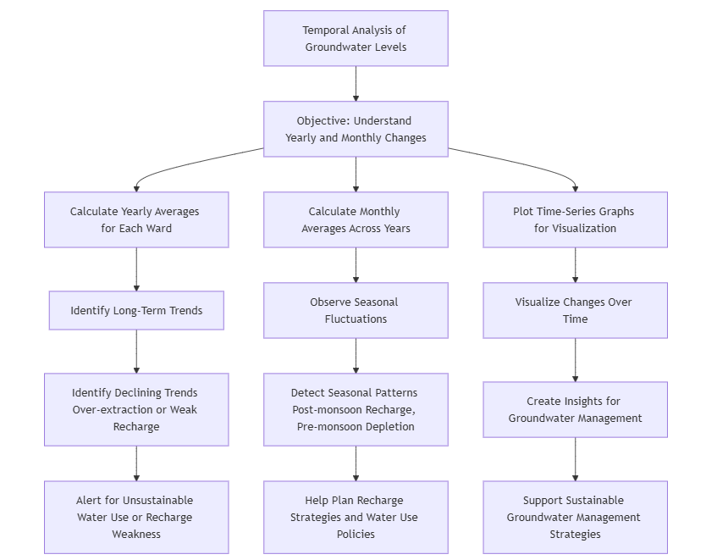
METHADOLOGY
III. DATA ANALYSIS APPROACHES
1. Temporal Analysis of Groundwater Levels
Objective: Understand how groundwater levels have changed over the years and months.
Method:
Calculate yearly averages for each ward to identify long-term trends.
Calculate monthly averages across years to observe seasonal fluctuations.
Plot time-series graphs to visualize changes.
Insights:
Identify declining trends that indicate over-extraction or weak recharge.
Detect seasonal patterns (e.g., post-monsoon recharge, pre-monsoon depletion).

Slide 34
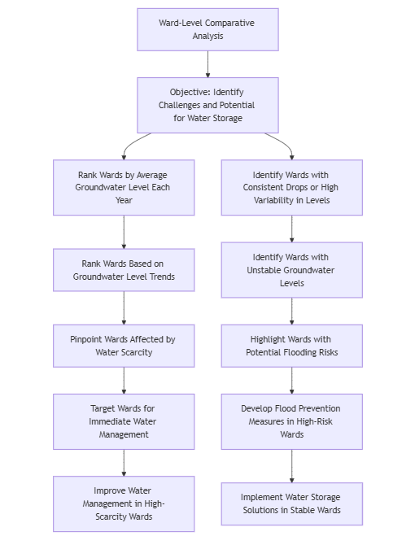
METHADOLOGY
III. DATA ANALYSIS APPROACHES
2. Ward-Level Comparative Analysis
Objective: Identify which wards face the greatest challenges or have the best potential for water storage.
Method:
Rank wards by average groundwater level each year.
Identify wards with consistent drops or high variability in levels.
Insights:
Pinpoint wards most affected by water scarcity or potential flooding.
Highlight wards with relatively stable groundwater levels as benchmarks.

Slide 35
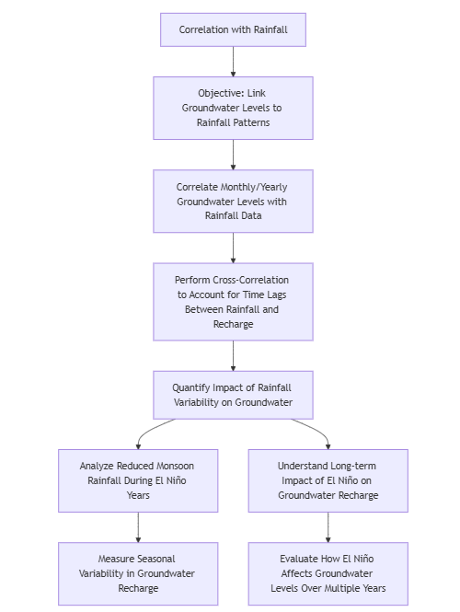
METHADOLOGY
III. DATA ANALYSIS APPROACHES
3. Correlation with Rainfall (If Available)
Objective: Link groundwater level fluctuations to rainfall patterns influenced by El Niño.
Method:
Correlate monthly/yearly groundwater levels with corresponding rainfall data.
Perform cross-correlation to account for time lags between rainfall and recharge.
Insights:
Quantify the impact of rainfall variability (e.g., reduced monsoon rainfall during El Niño years) on groundwater levels.

Slide 36
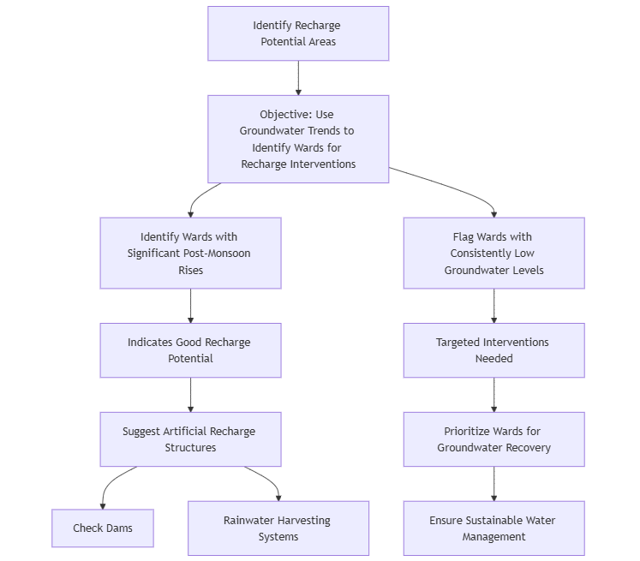
METHADOLOGY
III. DATA ANALYSIS APPROACHES
4. Identify Recharge Potential Areas
Objective: Use groundwater trends to locate wards that could benefit from water recharge/storage interventions.
Method:
Identify wards with significant post-monsoon rises (indicating good recharge potential).
Flag wards with consistently low levels for targeted interventions.
Insights:
Suggest specific wards for artificial recharge structures like check dams or rainwater harvesting.

Slide 37
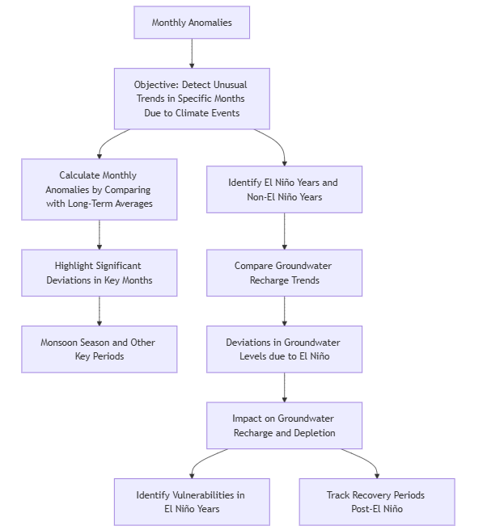
METHADOLOGY
III. DATA ANALYSIS APPROACHES
5. Monthly Anomalies
Objective: Detect unusual trends in specific months due to climate events (e.g., El Niño).
Method:
Calculate monthly anomalies by comparing current levels with long-term averages.
Highlight significant deviations in key months (e.g., monsoon season).
Insights:
Detect how El Niño years deviate from non-El Niño years in terms of groundwater recharge.

Slide 38
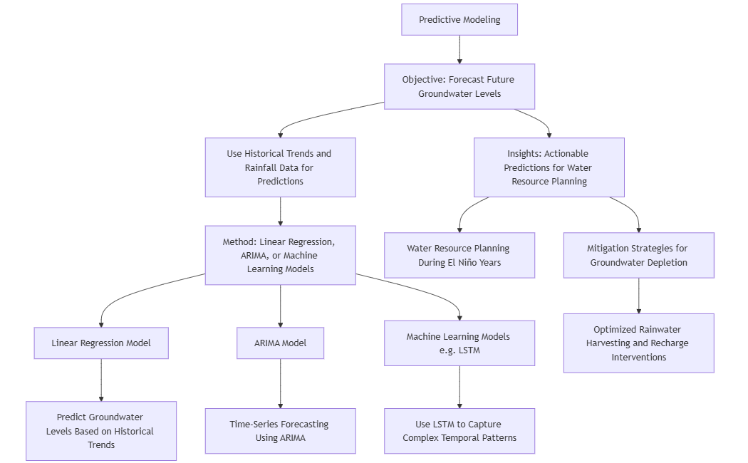
METHADOLOGY
III. DATA ANALYSIS APPROACHES
6. Predictive Modeling
Objective: Forecast future groundwater levels under different scenarios.
Method:
Use linear regression, ARIMA, or machine learning models (e.g., LSTM) to predict levels based on historical trends and rainfall.
Insights:
Provide actionable predictions for water resource planning and mitigation during El Niño years.

Slide 39
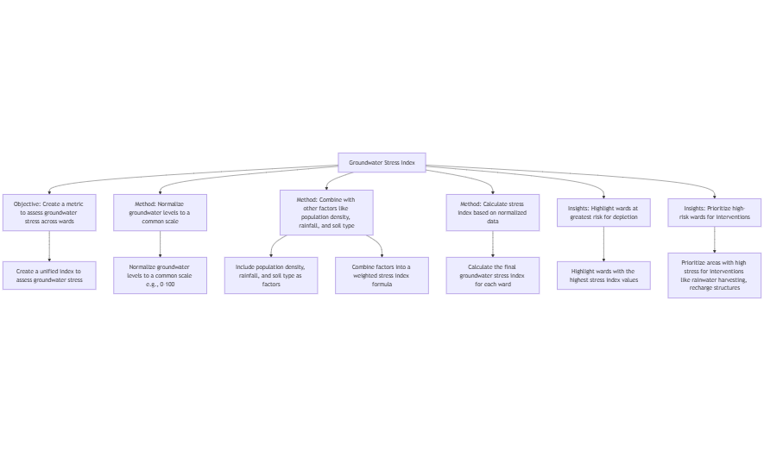
METHADOLOGY
III. DATA ANALYSIS APPROACHES
7. Groundwater Stress Index
Objective: Create a metric to assess groundwater stress across wards.
Method:
Normalize groundwater levels to a common scale.
Combine with other factors (e.g., population density, rainfall, soil type) to calculate a stress index.
Insights:
Highlight wards at greatest risk and prioritize them for interventions.

Slide 40
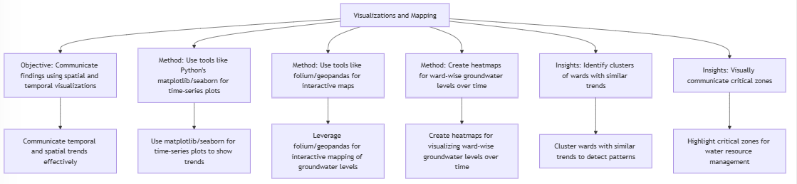
METHADOLOGY
III. DATA ANALYSIS APPROACHES
8. Visualizations and Mapping
Objective: Communicate findings effectively using spatial and temporal visualizations.
Method:
Use tools like Python’s matplotlib/seaborn for time-series plots and folium/geopandas for interactive maps.
Create heatmaps showing ward-wise groundwater levels over time.
Insights:
Identify clusters of wards with similar trends and visually communicate critical zones.

Slide 41
PROPOSED SYSTEM

Slide 42
PROPOSED SYSTEM INTRODUCTION
Objective:
The proposed system aims to provide accurate groundwater level prediction and identify suitable locations for water storage and recharge interventions, particularly in response to the impacts of El Niño events on Chennai’s groundwater levels.
Key Features:
Data Integration: Utilizes historical climate, groundwater, and satellite data for accurate predictions.
Predictive Modeling: Leverages machine learning models, such as LSTM and Random Forest, for groundwater level prediction.
Location Identification: Identifies optimal wards for artificial recharge and rainwater harvesting interventions.
Real-Time Monitoring: Uses interactive maps and heatmaps for ongoing analysis of groundwater levels and recharge potential.
Scope:
The system will be applicable to urban and peri-urban areas in Chennai but can be expanded to other regions facing similar water challenges.

Slide 43
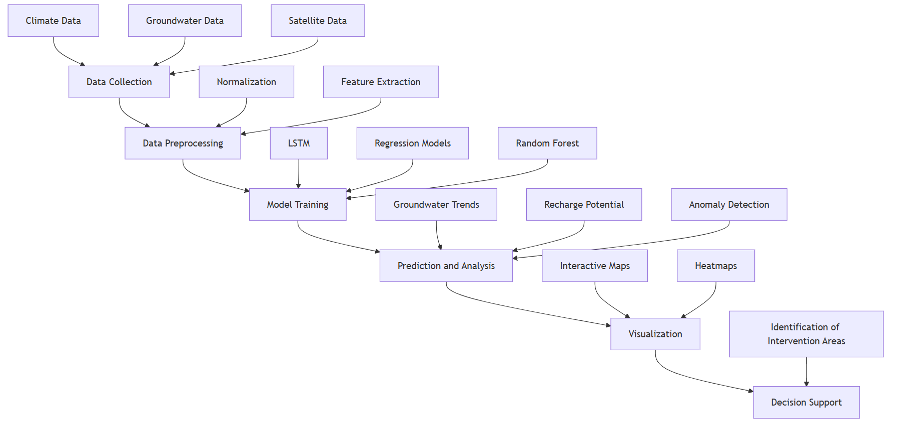
PROPOSED SYSTEM DIAGRAM

Slide 44
LIST OF MODULES
Data Collection and Preprocessing
Predictive Modeling
Recharge Potential Identification
Monthly Anomalies Detection
Decision Support for Water Resource Management

Slide 45
MODULE 1: DATA COLLECTION AND PREPROCESSING
Objective:
Collect and preprocess the climate, groundwater, and satellite data for further analysis.
Steps:
Climate Data: Rainfall, temperature, and other climate variables.
Groundwater Data: Historical groundwater levels across different wards.
Satellite Data: MODIS NDVI and imagery for identifying land use and vegetation patterns.
Preprocessing Techniques:
Normalization of the data for uniform scale.
Data cleaning (handling missing values, removing outliers).
Feature selection to focus on key influencing factors.

Slide 46
MODULE 2: PREDICTIVE MODELING
Objective:
Develop predictive models to forecast future groundwater levels based on historical trends and climatic influences, such as El Niño.
Algorithm(s):
Linear Regression: Simple model for capturing trends in groundwater levels.
LSTM (Long Short-Term Memory): Deep learning model used for time-series prediction considering past data for future predictions.
Random Forest: Ensemble learning model for handling non-linear relationships and complex interactions.
Steps:
Train the models using historical data.
Validate the models using metrics like RMSE (Root Mean Squared Error) and R².
Compare different models' performance to select the best one.

Slide 47
MODULE 3: RECHARGE POTENTIAL IDENTIFICATION
Objective:
Identify wards that have high potential for groundwater recharge through artificial interventions (e.g., rainwater harvesting, check dams).
Steps:
Identify Post-Monsoon Rises: Identify wards where groundwater levels show significant increases after the monsoon, indicating recharge potential.
Flag Low-Levels Wards: Identify wards with consistently low groundwater levels for targeted intervention.
Output:
A map and report showing high recharge potential areas.

Slide 48
MODULE 4: MONTHLY ANOMALIES DETECTION
Objective:
Detect unusual trends in groundwater levels for specific months, especially during El Niño events.
Algorithm(s):
Anomaly Detection: Compare monthly data with long-term averages to highlight significant deviations.
Time Series Analysis: Use statistical methods like ARIMA (AutoRegressive Integrated Moving Average) to identify patterns in groundwater levels.
Steps:
Calculate monthly anomalies for each ward.
Visualize significant deviations and correlate them with El Niño years to detect patterns of groundwater recharge or depletion.

Slide 49
MODULE 5: DECISION SUPPORT FOR WATER RESOURCE MANAGEMENT
Objective:
Provide actionable recommendations for water resource management and mitigation strategies during El Niño years.
Output:
Prediction Reports: Forecast future groundwater levels based on scenarios.
Intervention Suggestions: Provide specific recommendations for rainwater harvesting, artificial recharge, and sustainable water usage in critical wards.
Algorithm(s):
Optimization Algorithms: For identifying the most effective water storage or recharge solutions.
Scenario Analysis: Using predictive models to simulate different climate scenarios and their impact on groundwater levels.

Slide 50
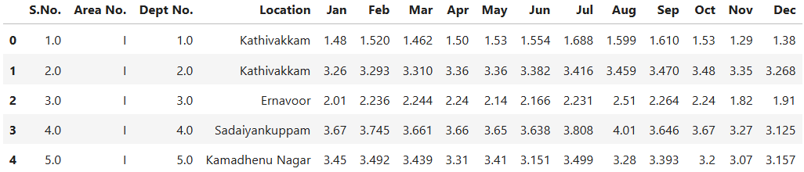
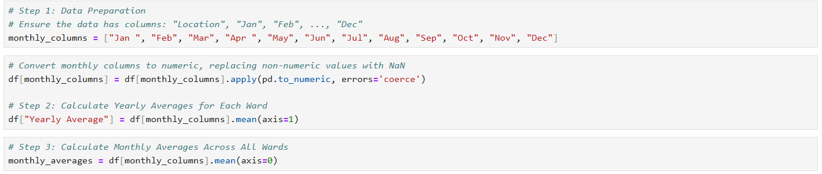
WHAT IS TO BE DONE NEXT
Data Collection & Integration
Gather historical climate, groundwater, and satellite data.
Ensure data consistency and address gaps.
Data Preprocessing
Normalize and clean the data.
Perform feature extraction to select relevant variables.

Slide 51
RESEARCH PAPER STATUS
End of February (70% Completion)
Focus: Completing project work, finalizing data collection, and analysis.
Key Milestones:
Finalizing model development and validation.
Completing core project documentation (methodology, results, analysis).
March (100% Completion)
Focus: Wrapping up any remaining project tasks and finalizing the research paper.
Key Milestones:
Completing the research paper draft (by March 12, 2025)
Reviewing, editing, and formatting the paper for submission.

Slide 52

GUIDE APPROVAL MAIL

Slide 53
REFERENCES
1. Alam, M. J., Kar, S., Zaman, S., Ahamed, S., & Samiya, K. (2022). Forecasting underground water levels: LSTM-based model outperforms GRU and decision tree-based models. 2022 IEEE International Women in Engineering (WIE) Conference.
2. Chen, C., Zhu, X., Kang, X., & Zhou, H. (2021). A deep learning algorithm for groundwater level prediction based on spatial-temporal attention mechanism. 2021 IEEE International Conference on Dependable, Autonomic and Secure Computing.
3. Indriasari, N., Roswintiarti, O., Rasyidy, F. H., Sari, I. L., Kustiyo, Muradi, H., et al. (2023). Temporal variation of MODIS NDVI in the North Coast Java during El Niño and La Niña. 2023 IEEE International Conference on Aerospace Electronics and Remote Sensing Technology (ICARES).
4. Lin, H., et al. (2022). Time series-based groundwater level forecasting using gated recurrent unit deep neural networks. Engineering Applications of Computational Fluid Mechanics.
5. Mu, B., Ma, S., Yuan, S., & Xu, H. (2020). Applying convolutional LSTM network to predict El Niño events: Transfer learning from the data of dynamical model and observation. 2020 IEEE International Conference on Dependable, Autonomic, and Secure Computing.
6. Nhu, V.-H., Hoa, P. V., Melgar-García, L., & Bui, D. T. (2023). Comparative analysis of deep learning and swarm-optimized random forest for groundwater spring potential identification in tropical regions. Remote Sensing MDPI.

Slide 54
REFERENCES
7. Satizábal-Alarcón, D. A., Suhogusoff, A., & Ferrari, L. C. (2022). Groundwater storage changes in the Amazon River Basin using machine learning models to downscale GRACE/GRACE-FO data. Science of the Total Environment, 912, 168958.
8. Shekhar, M., Shindekar, M., Tomer, S. K., & Goswami, P. (2013). Urban groundwater vulnerability under climate change and management scenarios. Earth Interactions, 17.
9. Sriram, R., & Jasmeen. (2023). Groundwater level prediction: A novel study on machine learning-based approach with regression models for sustainable resource management. 2023 IEEE International Conference on Cloud Computing in Emerging Markets (CCEM).
10. Shu, G., Liang, C., & Yin, Y. (2023). GSTCN: Graph-based spatial-temporal convolutional networks for advanced ENSO forecasting. 2023 International Conference on Computer Science and Automation Technology (CSAT).
11. Subbarayan, S., & Devanatham, A. (2023). Flood susceptibility mapping of northeast coastal districts of Tamil Nadu, India, using multi-source geospatial data and machine learning techniques. Research Gate.
12. Sundararajan, K., Garg, L., Srinivasan, K., Bashir, A. K., Kaliappan, J., Ganapathy, P. G., Selvaraj, S. K., & Meena, T. (2023). Drought modeling using machine learning approaches. Computer Modelling in Engineering & Sciences. Tech Science Press.

Slide 55
REFERENCES
13. Sundaram, S., Devaraj, S., & Yarrakula, K. (2023). Mapping and assessing spatial extent of floods from multitemporal synthetic aperture radar images: A case study over Chennai city, India. Research Square.
14. Zhang, Y., Wang, R., Yang, M., Zhu, M., & Ye, C. (2018). Using full-traversal addition-subtraction frequency (ASF) method to predict possible El Niño events in 2019, 2020 and so forth. 2018 Chinese Control and Decision Conference (CCDC).
15. Phu, G.-H., Joa, P. V., García, L., & Bui, D. T. (2021). Comparative analysis of machine learning and random forest for groundwater spring potential identification in tropical regions. Remote Sensing MDPI.

Slide 56
Thank you!
PROJECT-II (BCSE498J) PANEL REVIEW - I
Shaikh Rumman Fardeen
Ojas Aklecha
Shahshank Kumar
January, 2025

